Slide 1



Prince Mohammad Bin Fahd University
SkyPath Program

Slide 2


01 Program Overview
02
Program Objectives
TABLE OF CONTENTS
P R O J E C T T I T L E
03
Program Benefits
04
Program Features

Slide 3
Program Overview
P R O J E C T T I T L E

Slide 4
SkyPath Program Overview
The SkyPath Program is a PMU initiative designed to bridge the gap between high school and university life.
Students experience university-level courses, explore different academic fields, and spend a full day on campus. This early exposure helps them develop confidence, academic skills, and make informed decisions about their future majors.
P R O J E C T T I T L E

Slide 5





SkyPath Program Objectives
P R O J E C T T I T L E
To strengthen collaboration between the Admissions Department and academic units in supporting students’ transition from school to university life.
Develop communication, academic, and critical thinking skills
Introduce students to different academic disciplines through real university experiences.
Encourage students to pursue higher education with confidence and clear goals

Slide 6


SkyPath Program Benefits
Benefits for PMU
Community engagement
Early student recruitment
Stronger academic outreach
P R O J E C T T I T L E
Benefits for Students
Discover academic interests
Improve confidence
Experience university life
Make informed major choices
Benefits for Schools
Stronger partnership with PMU
Better student preparation

Slide 7



SkyPath Program Features
University-level learning experience
Academic major exploration
P R O J E C T T I T L E
Interaction with PMU faculty and students
Real campus experience

Slide 8




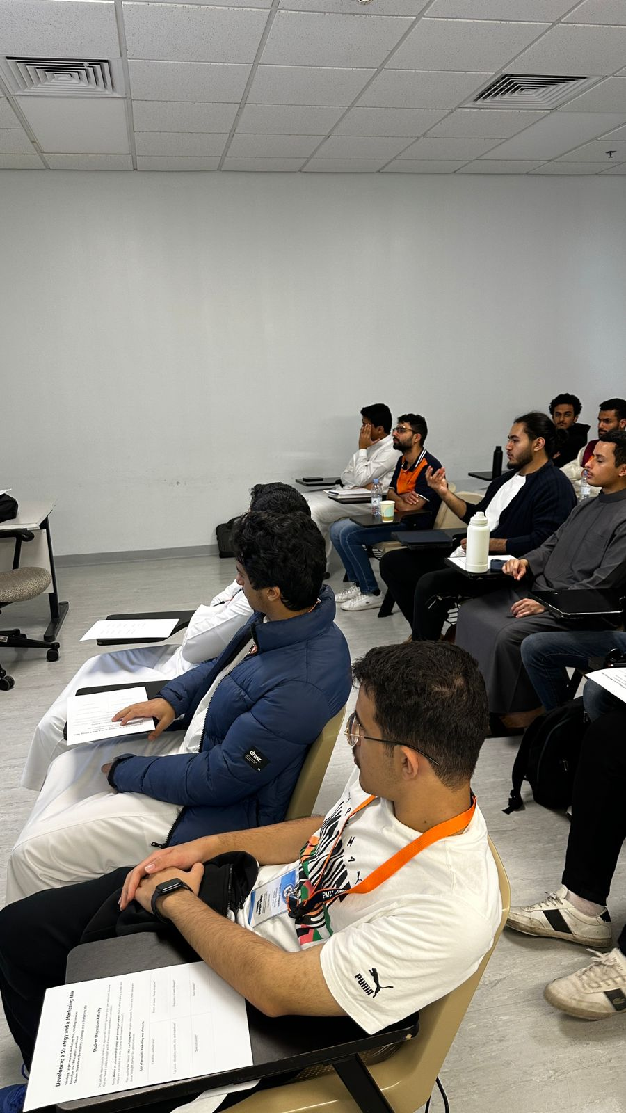
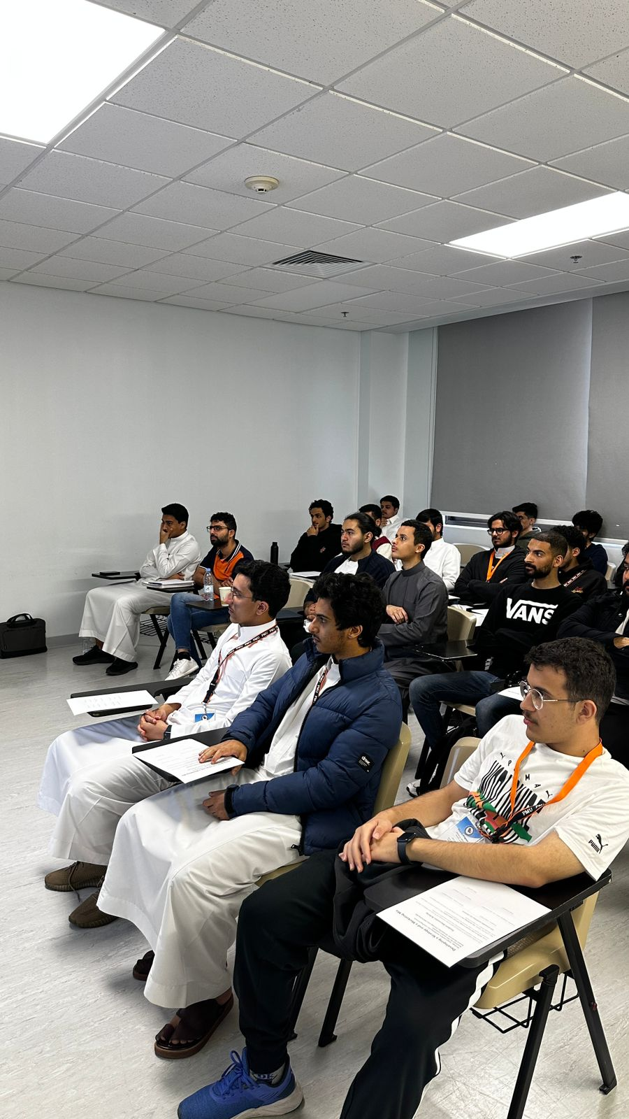

SkyPath School visit
P R O J E C T T I T L E
IMAGE 1
High school students attending Marketing principles course

Slide 9
THANK
P R O J E C T T I T L E
YOU
pmu.edu.sa

Slide 10




#042745
#19376e #f37022
#ada8a0
Fonts used
Arial
Fonts used
El-Messiri- Semi Bold
Title
Size – 43.1
Title
دهف نب دمحم ريملاا ةعماج
Sub-Header
Helvetica
Size – 13.1
Sub-Header
GE SS Two Medium
Numbers
Cormorant
Size – 45
دهف نب دمحم ريملأا ةعماج
Numbers
18 Khebrat
Musamim
دهف نب دمحم ريملاا ةعماج

Slide 11
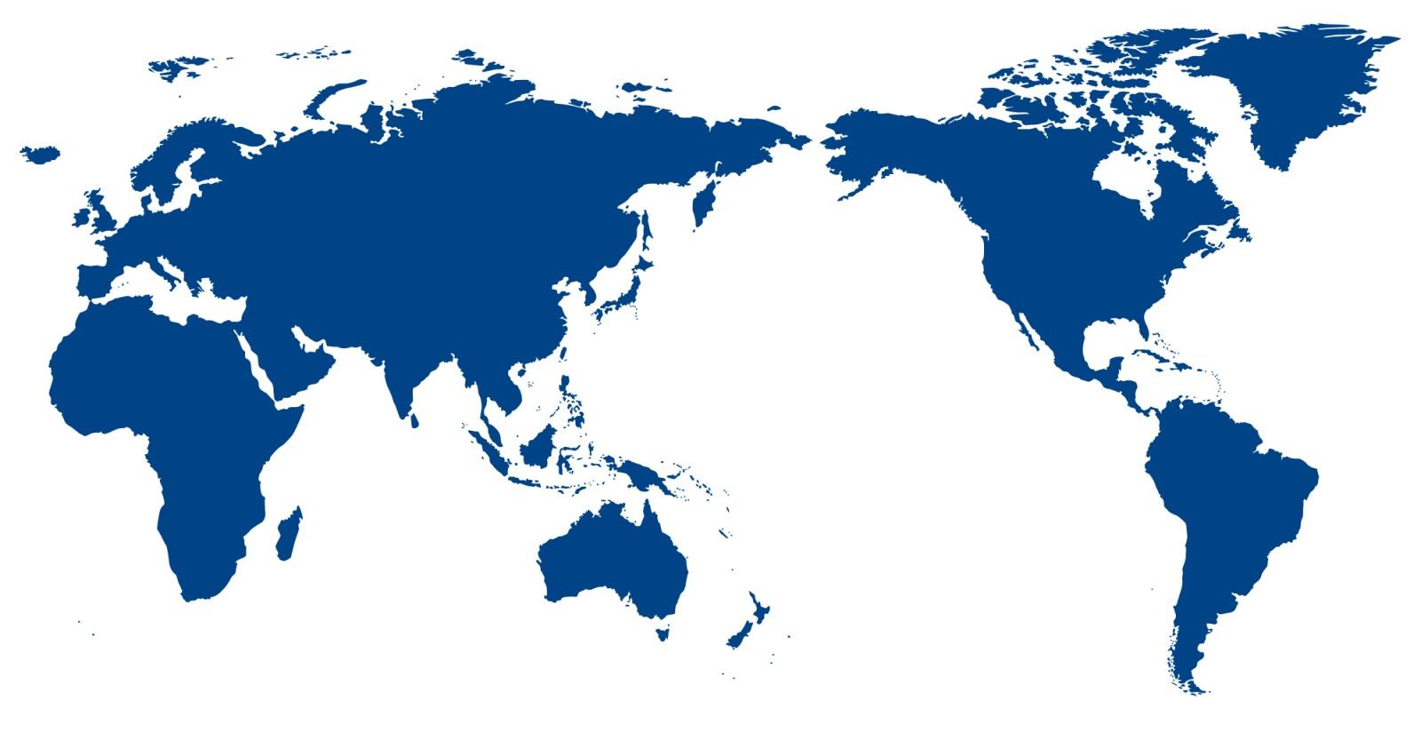
Prince Mohammad Bin Fahd University
CREATIVE MINDS… TRANSFORM THE WORLD
11

